Slide 1

Introduction
(Unit-I)
Dr.M.Velavan
Faculty
School of Management
SASTRA Deemed University
Thanjavur – 613 401

Slide 2
1. Introduction:
Finance is the life blood of a business. The Financial Management study about the process of procuring and judicious use of financial resources with a view to maximising the value of the firm there by the value of the owners (equity shareholders).
The traditional view of the Financial Management looks in to the following functions, that a finance a manager of a business firm will perform:
Arrangement of short term and long term funds from financial institutions.
Mobilisation of funds through financial instruments.
Orientation of Finance Function with Accounting Function and compliance of legal provisions relating to funds procurement, use and distribution.

Slide 3
2. Meaning and definition of Financial Management:
Meaning:
Financial management is managerial activity which is concerned with the planning and controlling of the firm’s financial resources.
Definitions:
Howard and Uptron define financial management “as an application of general managerial principles to the area of financial decision-making”.
Weston and Brighem define financial management “as an area of financial decision making, harmonizing individual motives and enterprise goal”.

Slide 4
“Financial management is concerned with the efficient use of an important economic resource, namely capital funds” - Solomon Ezra & J. John Pringle.
“Financial management is the operational activity of a business that is responsible for obtaining and effectively utilizing the funds necessary for efficient business operations”- J.L. Massie.

Slide 5
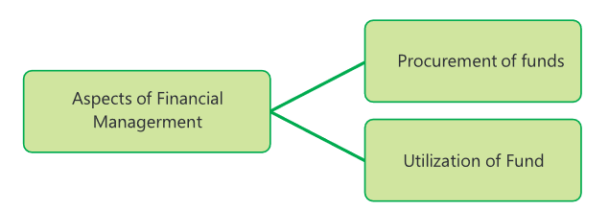
There are two basic aspects of financial management viz., procurement of funds and an effective use of these funds to achieve business objectives:

Slide 6
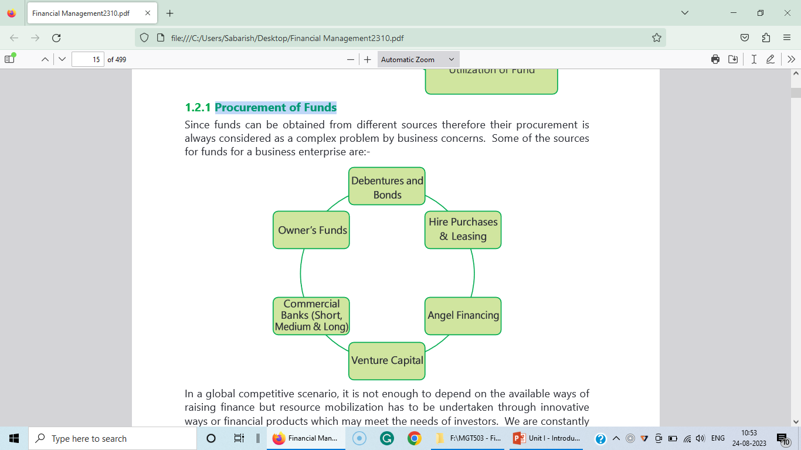
1. Procurement of Funds:

Slide 7
2. Utilisation of Funds:
Utilization for Fixed Assets:
The funds are to be invested in a manner so that the company can produce at its optimum level without endangering its financial solvency. For this, the finance manager would be required to possess sound knowledge of techniques of capital budgeting. Capital budgeting (or investment appraisal) is the planning process used to determine whether a firm’s long-term investments such as new machinery, replacement machinery, new plants, new products, and research development projects would provide the desired return (profit).

Slide 8
b) Utilization for Working Capital:
The finance manager must also keep in view the need for adequate working capital and ensure that while the firms enjoy an optimum level of working capital they do not keep too many funds blocked in inventories, book debts, cash, etc.

Slide 9
3. Scope of financial management:
Financial Management today covers the entire gamut of activities and functions given below. The head of finance is considered to be importantly of the CEO in most organizations and performs a strategic role. His responsibilities include :
a. Estimating the total requirements of funds for a given period.
b. Raising funds through various sources, both national and international, keeping in mind the cost effectiveness.
c. Investing the funds in both long term as well as short term capital needs.
d. Funding day-to-day working capital requirements of business.
e. Collecting on time from debtors and paying to creditors on time.
f. Managing funds and treasury operations.
g. Ensuring a satisfactory return to all the stake holders.

Slide 10
h. Paying interest on borrowings.
i. Repaying lenders on due dates;
j. Maximizing the wealth of the shareholders over the long term;
k. Interfacing with the capital markets.
l. Awareness to all the latest developments in the financial markets.
m. Increasing the firm’s competitive financial strength in the market.
n. Adhering to the requirements of corporate governance.

Slide 11
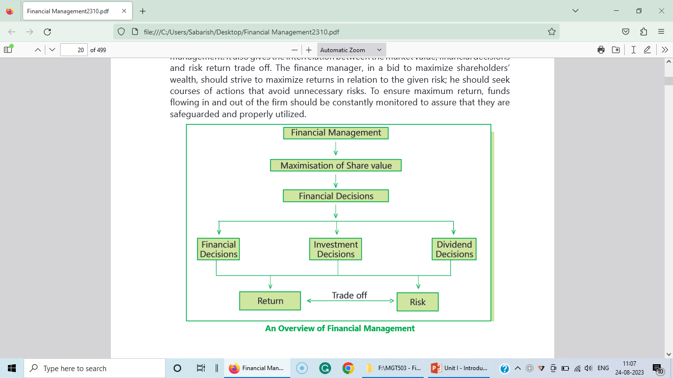

Slide 12
4. Functions of FM or Modern Approach to Financial Management:
In view of the modern approach, the Finanace Manager is expected to analyse the firm and to determine the following:
The total funds requirement of the firm.
The assets to be acquired.
The pattern of financing the assets.
The Financial Manager of a modern business firm will generally involve in the following three types of decisions.
Investment decisions [I]
Financial decisions [F]
Dividend decisions [D]
V = f[I,F,D]

Slide 13
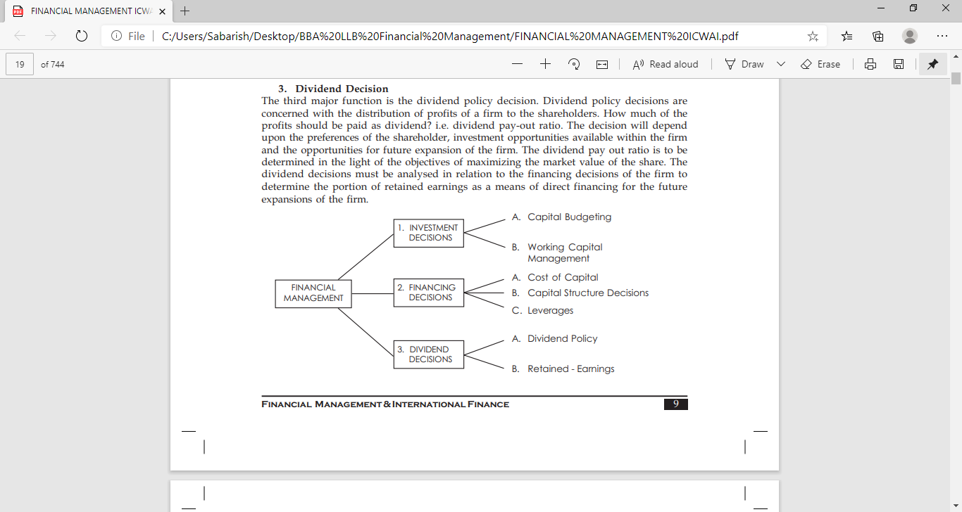

Slide 14
1. Investment Decisions:
Investment decisions relate to the careful selection of viable and profitable investment proposals, allocation of funds to the investment proposals with view to obtain net present value of the future earnings of the company and to maximize its value. The investment decisions of a Finance Manger cover the following areas:
Ascertainment of total volume of funds, a firm can commit.
Appraisal and selection of capital investment proposals.
Measurement of risk and uncertainty in the investment proposals.
Prioritisation of investment decisions.
Fund allocation and its rationing.

Slide 15
Determination of fixed assets to be required.
Determination of level of investment in current assets.
Buy or lease decision.
Assets replacement decisions.
Restructuring, reorganisation, merger and acquisition.
Securities analysis and portfolio management.

Slide 16
2. Financing decisions:
It is one of the important functions of a Finance Manger is procurement of funds for the firm’s investment proposals and its working capital requirements. The finance Manager involve in following finance decisions:
Determination of degree or level of gearing.
Determination of financing pattern of long-term funds requirements.
Determination of financing pattern of medium and short-term funds requirements.
Raising of funds through issue of financial instruments.
Arrangements of funds from banks and financial institutions for long-term requirements.

Slide 17
Arrangements of funds for working capital requirements.
Consideration of interest burden on the firm.
Consideration of debt level changes
Taking advantages of interest and depreciation
Portfolio Management.
Maintenance of balance between owners capital and outside capital

Slide 18
3. Dividend Decisions:
The dividend decisions of a Finance Manager is mainly concerned with the decision relating to the distribution of earnings of the firm among its equity shareholders and the amount to be retained by the Firm.
The Finance Manager will involve in taking the following dividend decisions:
Determination of dividend and retention policy of the firm.
Consideration of impact of level dividend and retention of earnings on the market value of the share and the future earnings of the Company.
Consideration of possible requirements of funds by the firm for expansion and diversification proposals for financing existing business requirements.
Reconsideration of distribution and retentions policies in boom and recession period.
Consideration of impact of legal and cash flow constraints on dividend decisions.

Slide 19
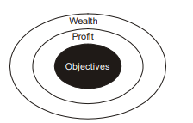
5. Objectives of financial management:
Effective procurement and efficient use of finance lead to proper utilization of the finance by the business concern. It is the essential part of the financial manager. Hence, the financial manager must determine the basic objectives of the financial management.
Objectives of Financial Management may be broadly divided into two parts such as:
Profit maximization
Wealth maximization.

Slide 20
a) Profit Maximization:
Main aim of any kind of economic activity is earning profit. A business concern is also functioning mainly for the purpose of earning profit. Profit is the measuring techniques to understand the business efficiency of the concern.
Profit maximization is also the traditional and narrow approach, which aims at, maximizes the profit of the concern. Profit maximization consists of the following important features.
1. Profit maximization is also called as cashing per share maximization. It leads to maximize the business operation for profit maximization.
2. Ultimate aim of the business concern is earning profit, hence, it considers all the possible ways to increase the profitability of the concern.
3.Profit is the parameter of measuring the efficiency of the business concern. So it shows the entire position of the business concern.
4. Profit maximization objectives help to reduce the risk of the business.

Slide 21

b) Wealth Maximization:
Wealth maximization is one of the modern approaches, which involves latest innovations and improvements in the field of the business concern. The term wealth means shareholder wealth or the wealth of the persons those who are involved in the business concern.
Wealth maximization is also known as value maximization or net present worth maximization. This objective is an universally accepted concept in the field of business

Slide 22
c) Other objectives of Financial Management:
Return on capital employed and return on investment
Value addition and profitability
Growth in earnings per share and price earning ratio
Growth in the market value of a share
Growth in dividends to shareholders
The optimum level of leverage
Survival and growth of the firm
Minimization of financial charges
Efficient utilization of short, medium, and long-term financing.

Slide 23
6. Profit Vs Wealth Maximization:
Financial Management as the name suggests is management of finance. It deals with planning and mobilization of funds required by the firm. There is only one thing which matters for everyone right from the owners to the promoters and that is money. Managing finance is nothing but managing money. Every activity of an organization is reflected in its financial statements.
Financial Management deals with activities that have financial implications. The very important objective of Financial Management is to maximize the wealth of the shareholders by maximizing the value of the firm. This prime objective of Financial Management is reflected in the EPS (Earning per Share) and the market price of its shares.

Slide 24
The earlier objective of profit maximization is now replaced by wealth maximization. Since profit maximization is a limited one it cannot be the sole objective of a firm. The term profit is a vague phenomenon and if given undue importance problems may arise whereas wealth maximization on the other hand overcomes the drawbacks of profit maximization. Thus the objective of Financial Management is to trade off between risk and return. The objective of Financial Management is to make efficient use of economic resources mainly capital.

Slide 25
7. Functions of Finance Manager:
Finance function is one of the major parts of business organization, which involves the permanent, and continuous process of the business concern.
Finance manager performs the following major functions:
1. Forecasting Financial Requirements:
It is the primary function of the Finance Manager. He is responsible to estimate the financial requirement of the business concern. He should estimate, how much finances required to acquire fixed assets and forecast the amount needed to meet the working capital requirements in future.
2. Acquiring Necessary Capital:
After deciding the financial requirement, the finance manager should concentrate how the finance is mobilized and where it will be available. It is also highly critical in nature.

Slide 26
3. Investment Decision:
The finance manager must carefully select best investment alternatives and consider the reasonable and stable return from the investment. He must be well versed in the field of capital budgeting techniques to determine the effective utilization of investment. The finance manager must concentrate to principles of safety, liquidity and profitability while investing capital.
4. Cash Management:
Present days cash management plays a major role in the area of finance because proper cash management is not only essential for effective utilization of cash but it also helps to meet the short-term liquidity position of the concern.

Slide 27
5. Interrelation with Other Departments:
Finance manager deals with various functional departments such as marketing, production, personnel, system, research, development, etc. Finance manager should have sound knowledge not only in finance related area but also well versed in other areas. He must maintain a good relationship with all the functional departments of the business organization.

Slide 28
8. Importance of Financial Management:
Finance is the lifeblood of business organization. It needs to meet the requirement of the business concern. Each and every business concern must maintain adequate amount of finance for their smooth running of the business concern and also maintain the business carefully to achieve the goal of the business concern. The business goal can be achieved only with the help of effective management of finance.
Some of the importance of the financial management is as follows:
1. Financial Planning:
Financial management helps to determine the financial requirement of the business concern and leads to take financial planning of the concern. Financial planning is an important part of the business concern, which helps to promotion of an enterprise.

Slide 29
2. Acquisition of Funds:
Financial management involves the acquisition of required finance to the business concern. Acquiring needed funds play a major part of the financial management, which involve possible source of finance at minimum cost.
3. Proper Use of Funds:
Proper use and allocation of funds leads to improve the operational efficiency of the business concern. When the finance manager uses the funds properly, they can reduce the cost of capital and increase the value of the firm.

Slide 30
4. Financial Decision:
Financial management helps to make sound financial decisions in the business concern. Financial decisions will affect the entire business operation of the concern. Because there is a direct relationship with various department functions such as marketing, production personnel, etc.
5. Improve Profitability:
The profitability of the concern purely depends on the effectiveness and proper utilization of funds by the business concern. Financial management helps to improve the profitability position of the concern with the help of strong financial control devices such as budgetary control, ratio analysis, and cost volume profit analysis.

Slide 31

6. Increase the Value of the Firm:
Financial management is very important in the field of increasing the wealth of the investors and the business concern. The ultimate aim of any business concern is to achieve the maximum profit and higher profitability leads to maximizing the wealth of the investors as well as the nation.
7. Promoting Savings:
Savings are possible only when the business concerned earns higher profitability and maximizes wealth. Effective financial management helps to promote and mobilize individual and corporate savings.

Slide 32
9. Risk-Return Tarde off:
The prime objective of financial management is to maximize the value of the firm, which is possible only when well-balanced financial decisions are taken. The management should try to maximize the average profit while minimizing the risk. The projects promising a high average profit are generally accompanied by high risk. The manager should accept such projects only if they will induce an increase in stock price. It is known that the “higher the return”, other things being equal, the “higher the market value” and vice versa.
Definition:
Higher risk is associated with a greater probability of higher return and lower risk with a greater probability of smaller return. This trade-off that an investor faces between risk and return while considering investment decisions is called the risk-return trade-off.

Slide 33
Risk-Return Trade – off:
Investment Decisions
Financing Decisions
Dividend Decisions
Return
Trade-off
Risk
Market value of firm

Slide 34
Thank You

